Slide 1


A Voice Tool For Deaf And Hearing
Communities
Keerthivasan S
23106091
Bsc cs shift 2
Dr.N.Mahendiran
Assistant professor.
srcas

Slide 2
Abstract
This project presents a Voice-to-Sign Language Translator that converts spoken English into corresponding sign language gestures using a curated word-level sign language video dataset. The system is designed to bridge communication gaps between hearing individuals and the Deaf community by enabling real-time translation of voice commands into sign language animations. The application integrates a speech recognition module to accurately transcribe spoken words, followed by a gloss-matching engine that identifies the appropriate sign videos from the dataset. The selected sign videos are then displayed instantly on a web-based chatbot-style interface, ensuring smooth and natural interaction. The system avoids storing video outputs on the server, focusing instead on efficient streaming for enhanced performance. This work demonstrates a practical, scalable, and accessible approach to assistive communication technology, showcasing the potential of AI-driven multimodal translation tools in inclusive digital environments.

Slide 3
Existing system
Existing communication systems between hearing and non-hearing individuals are limited in the following ways:
No real-time translation between speech and sign language.
Many tools rely only on text-to-sign, not voice-to-sign.
Existing apps often use GIF-based or low-quality sign animations, lacking accurate SL gesture mapping.
Manual interpretation through human sign-language interpreters is required in many scenarios.
Most available systems do not utilize large datasets like WLSL, which contains thousands of SL videos.
Limited accessibility tools for education, hospitals, classrooms, and public communication.
These limitations highlight the need for a more efficient and automated voice-to-sign translation system.

Slide 4
Proposed solution
The proposed system provides an automated pipeline that:
1. Captures user’s voice through a microphone.
2. Converts speech to text using ASR (Automatic Speech Recognition) such as Google Speech API or Vosk.
3. Extracts keywords and matches them with corresponding glosses in the WLSL dataset.
4. Streams the sign-language videos instantly in the user interface without storing them on the backend.
5. Displays videos in a chatbot-style UI, making the system interactive and user-friendly.

Slide 5

Software requirements
Backend
Python 3.9+
FastAPI
uvicorn
Google Cloud Speech / Vosk
OpenCV (optional)
WLSL dataset (video files)
Frontend
HTML, CSS, JavaScript
MediaRecorder API for audio capture
Video streaming support
Tools
VS Code
Browser (Chrome/Firefox)
Postman (optional, for API testing)

Slide 6
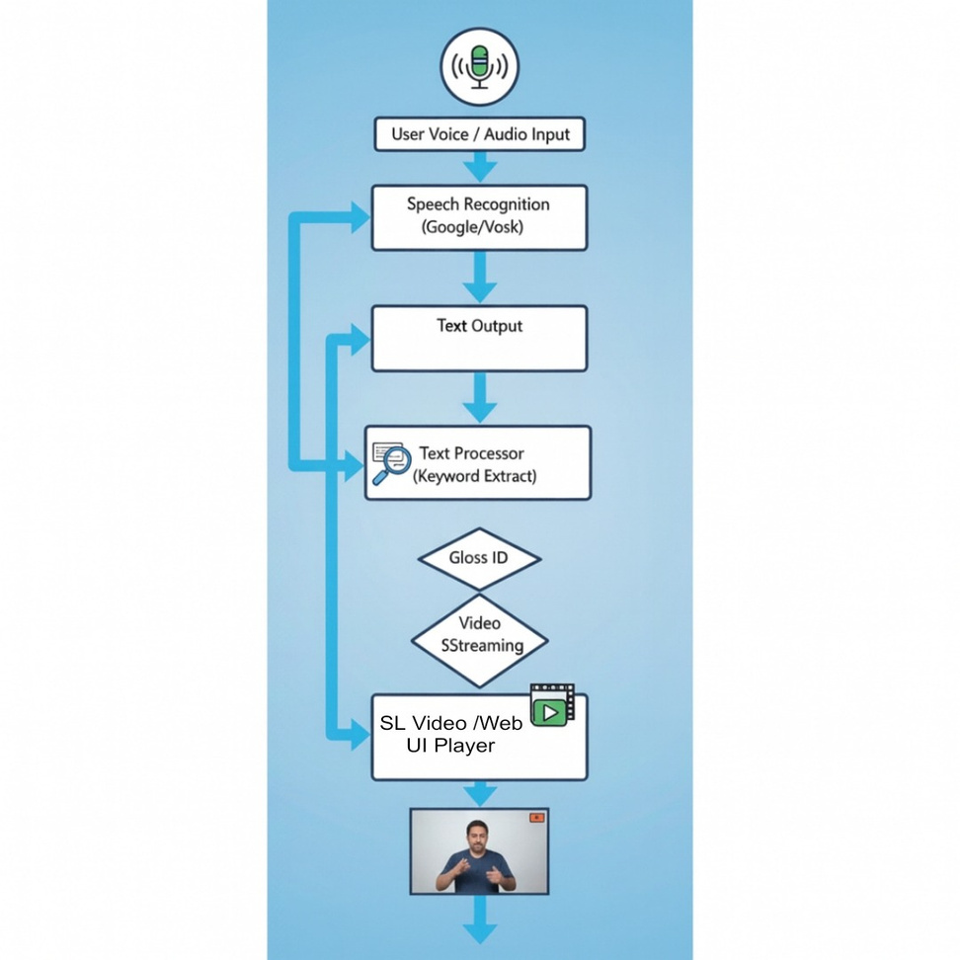
Data Flow diagram

Slide 7
Thank you!

